Slide 1
Thermodynamics I: Introduction
Experimentally measurable properties (e.g., P, V, T, ...)
States of matter (phase equilibria, critical and triple points)
Antoine equation
Definition(s) of temperature
Molecular pairwise interactions

Slide 2
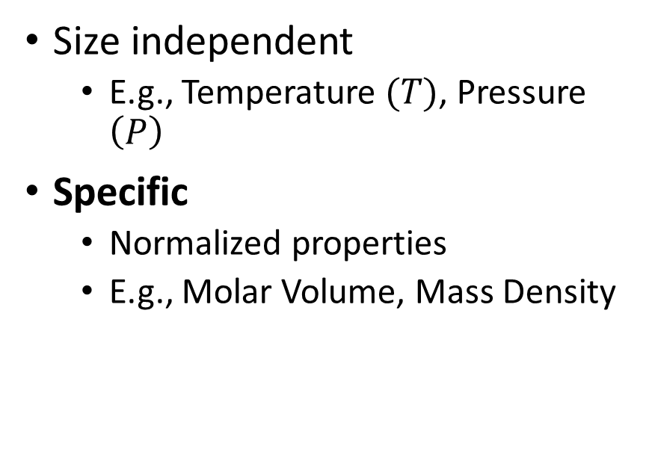
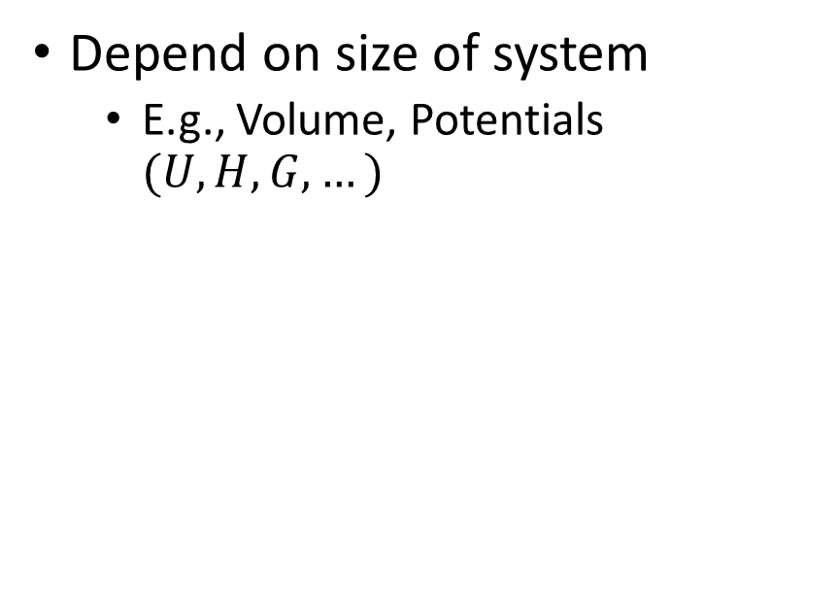
Thermodynamic Properties
Extensive
Intensive
Depend on size of system
E.g., Volume, Potentials $(U,H,G,…)$
Size independent
E.g., Temperature $(T)$, Pressure $\left(P\right)$
Specific
Normalized properties
E.g., Molar Volume, Mass Density

Slide 3
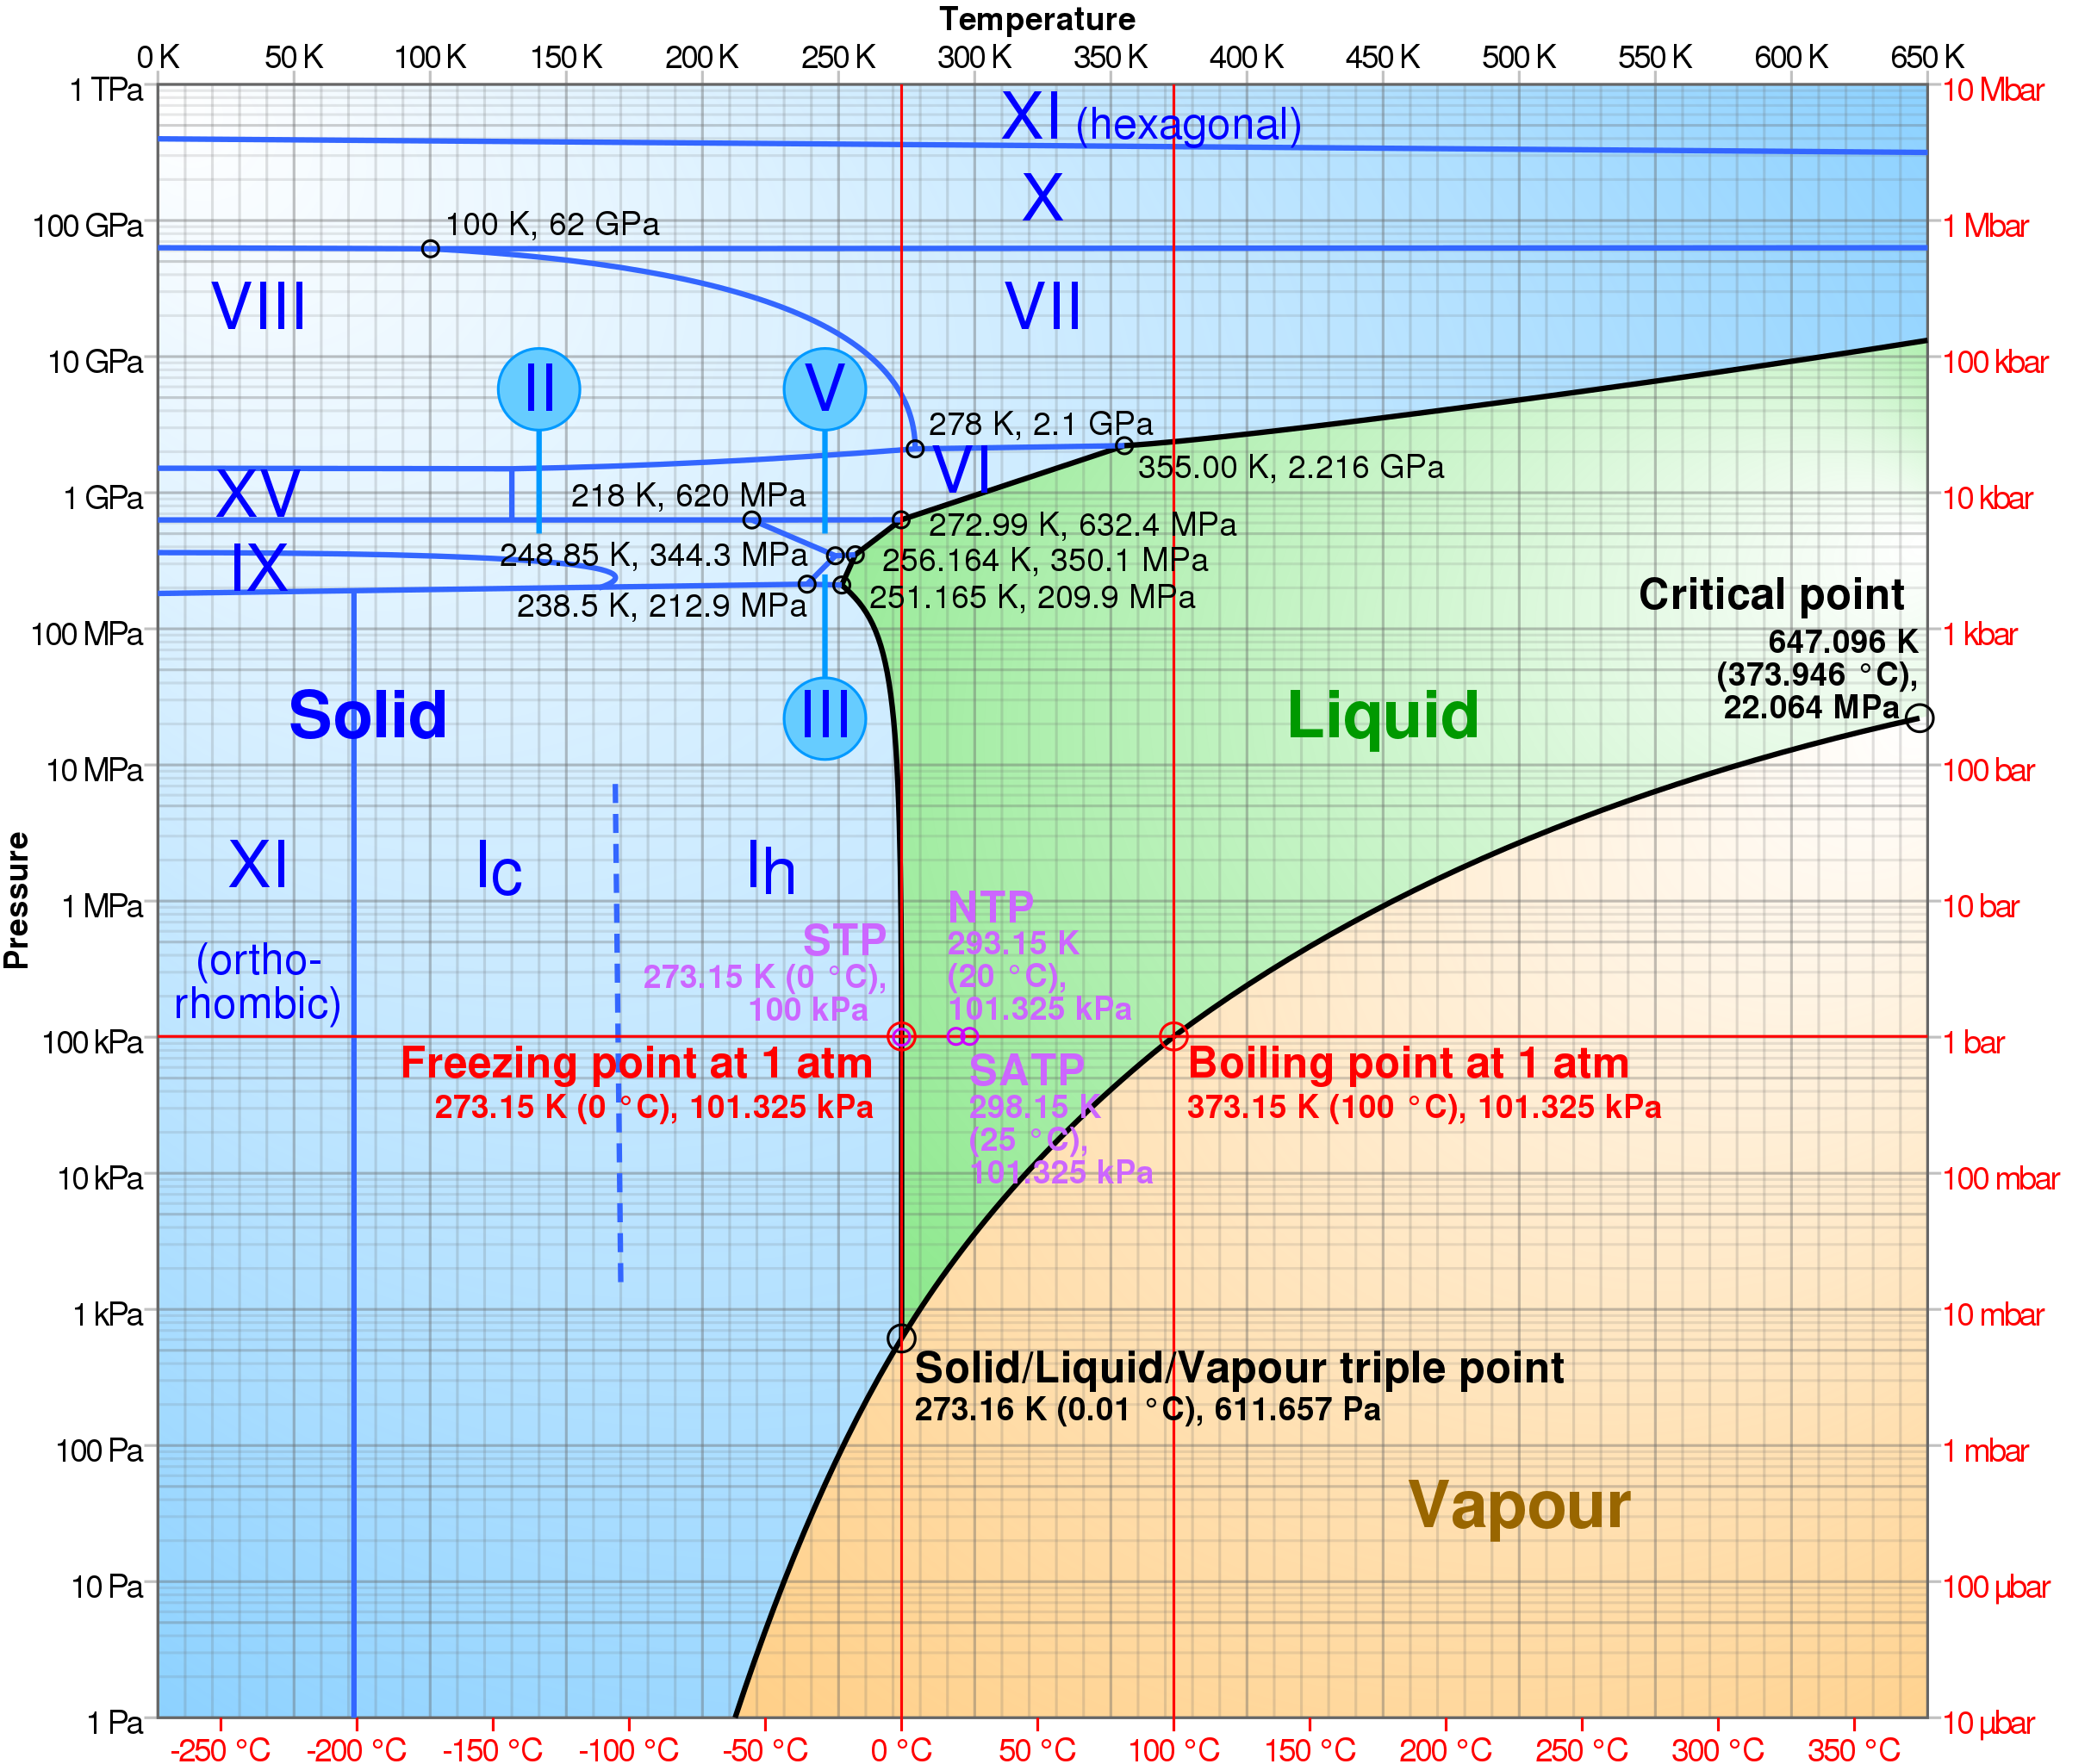
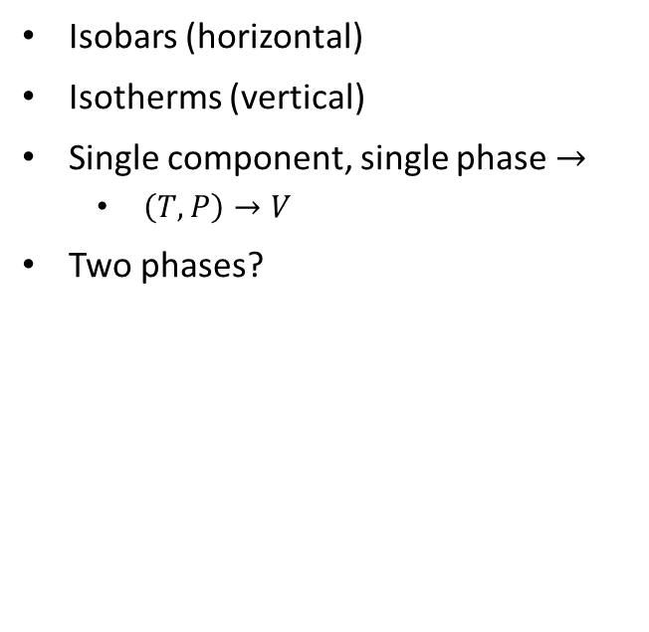
Phase Diagram (Water)
Isobars (horizontal)
Isotherms (vertical)
Single component, single phase $→$
$\left(T,P\right)→V$
Two phases?
Notes:
https://en.wikipedia.org/wiki/Properties_of_water

Slide 4
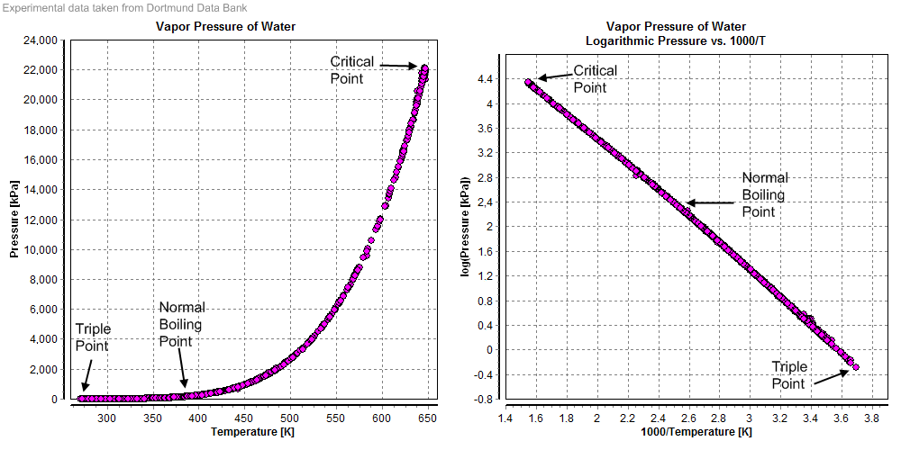
Vapor Pressure (Antoine’s Equation)
Notes:
https://en.wikipedia.org/wiki/Properties_of_water

Slide 5
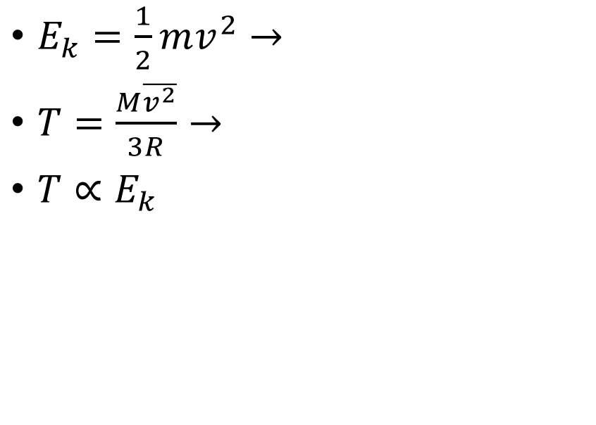
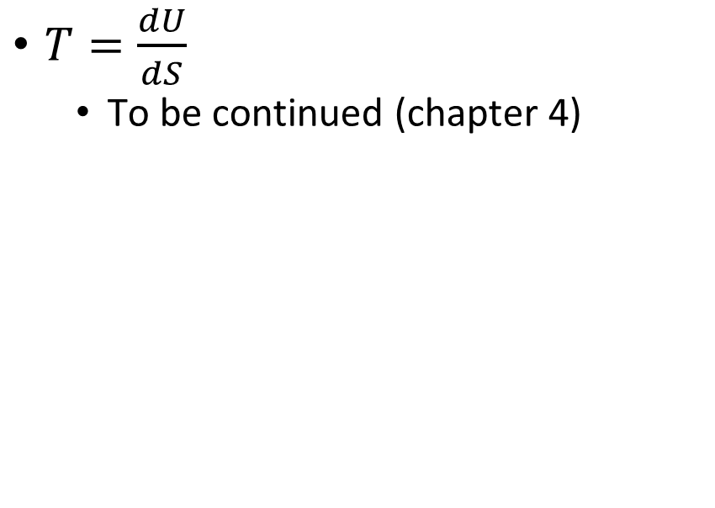
What is Temperature?
Kinetic Theory of Gases
Equilibrium (Entropy)
$E_{k}=\frac{1}{2}mv^{2}→$
$T=\frac{M\overline{v^{2}}}{3R}→$
$T∝E_{k}$
$T=\frac{dU}{dS}$
To be continued (chapter 4)
Notes:
Absolute temperature!

Slide 6
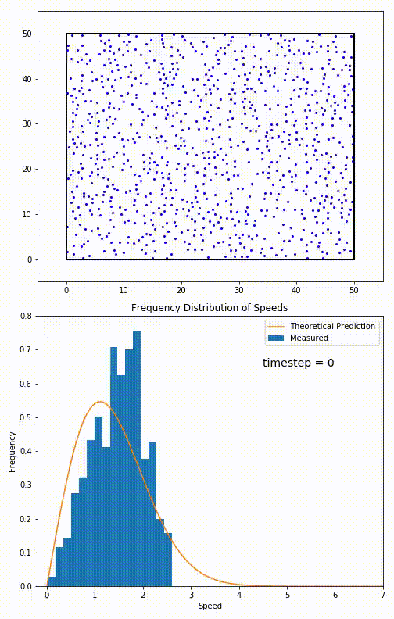
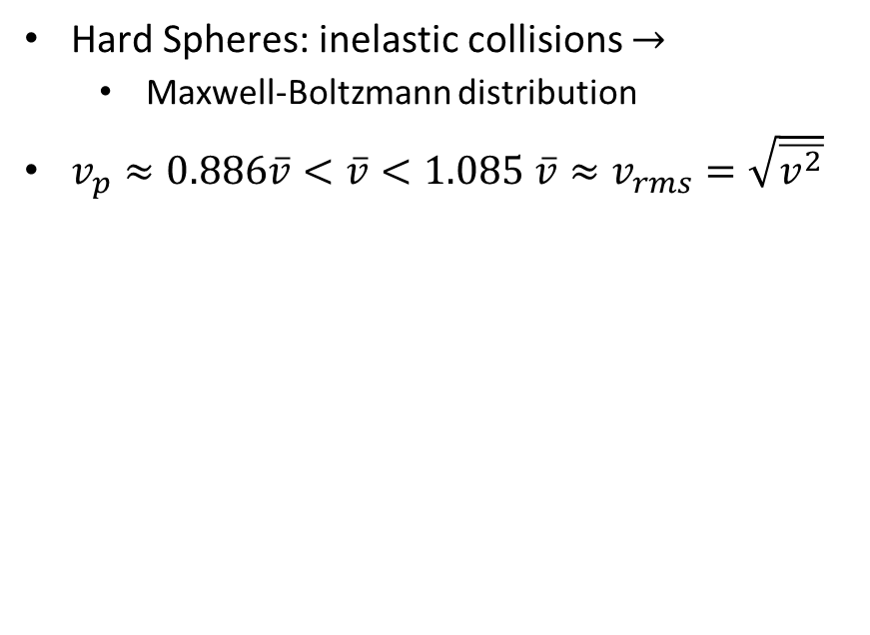
Velocity Distribution
Hard Spheres: inelastic collisions $→$
Maxwell-Boltzmann distribution
$v_{p}≈0.886\overline{v}<\overline{v}<1.085 \overline{v}≈v_{rms}=\sqrt{\overline{v^{2}}}$
Notes:
https://en.wikipedia.org/wiki/Maxwell%E2%80%93Boltzmann_distribution

Slide 7
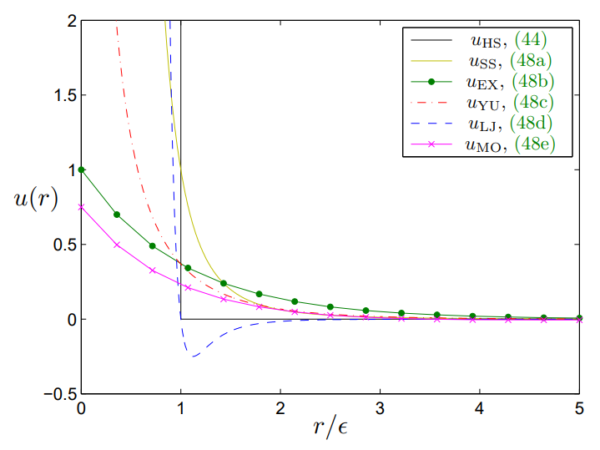
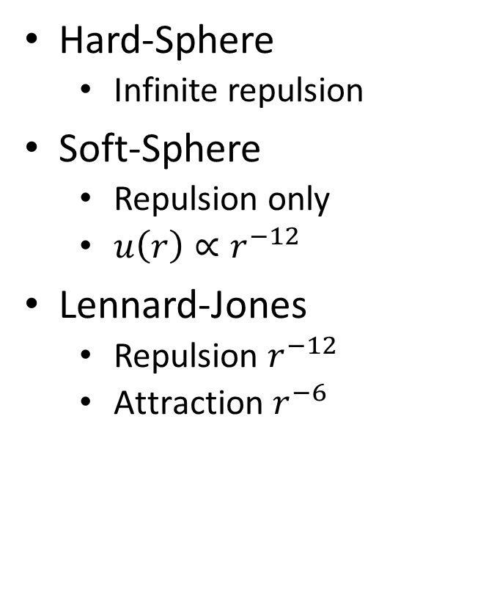
Intermolecular Pair Potentials
Hard-Sphere
Infinite repulsion
Soft-Sphere
Repulsion only
$u\left(r\right)∝r^{−12}$
Lennard-Jones
Repulsion $r^{−12}$
$\text{Attraction} r^{−6}$
Bruna, Maria & Chapman, Stephen & Robinson, Martin. (2017). Diffusion of Particles with Short-Range Interactions. SIAM Journal on Applied Mathematics. 77. 10.1137/17M1118543.

Slide 8
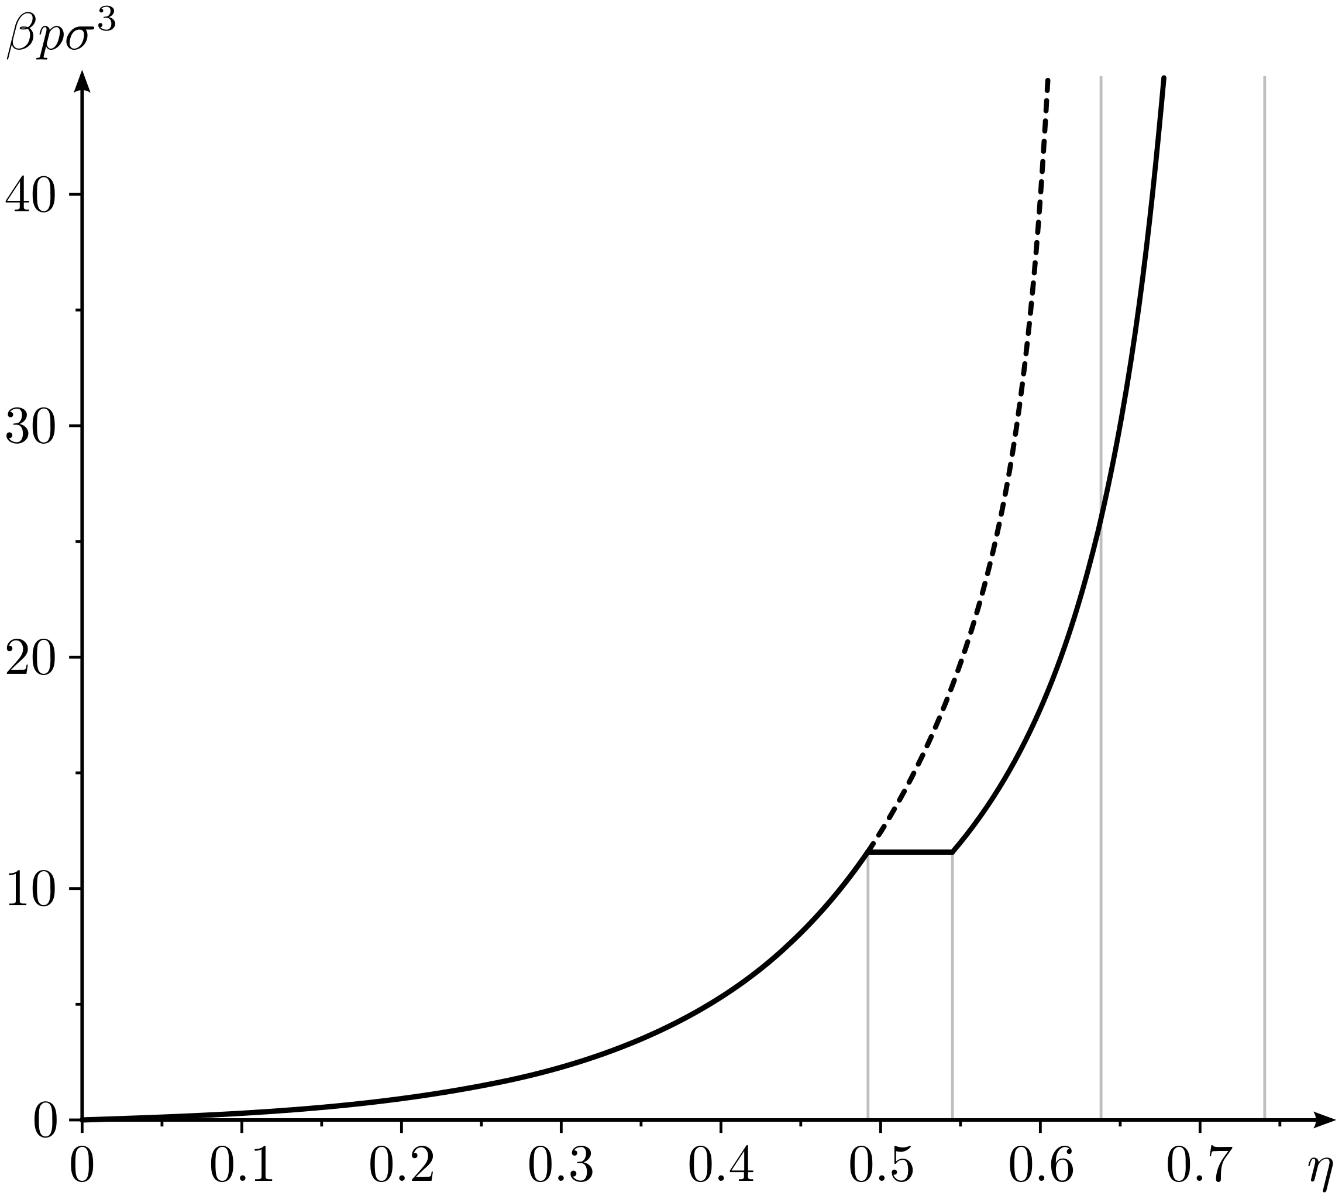
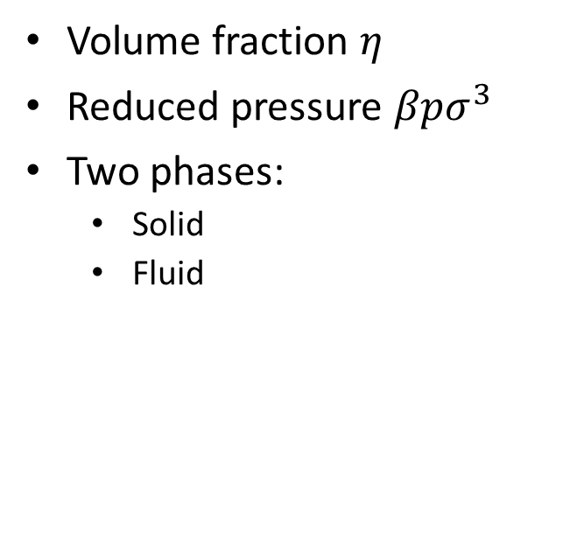
Hard Sphere Phase Diagram
Volume fraction $η$
Reduced pressure $βpσ^{3}$
Two phases:
Solid
Fluid
Notes:
https://en.wikipedia.org/wiki/Hard_spheres
Phase diagram of hard sphere system (Solid line - stable branch, dashed line - metastable branch): Reduced pressure as a function of the volume fraction (or packing fraction) .
Vertical grey lines indicate critical densities:
freezing: 0.494
melting: 0.545
random close packing: 0.644
close packing: 0.74

Slide 9
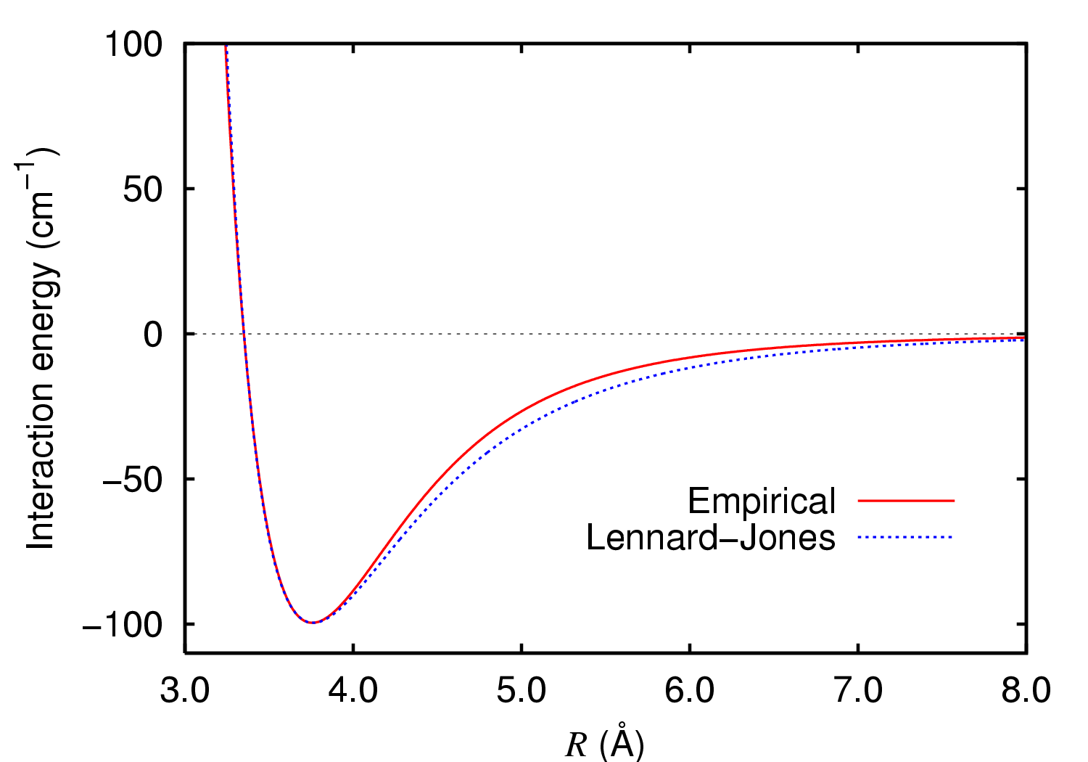
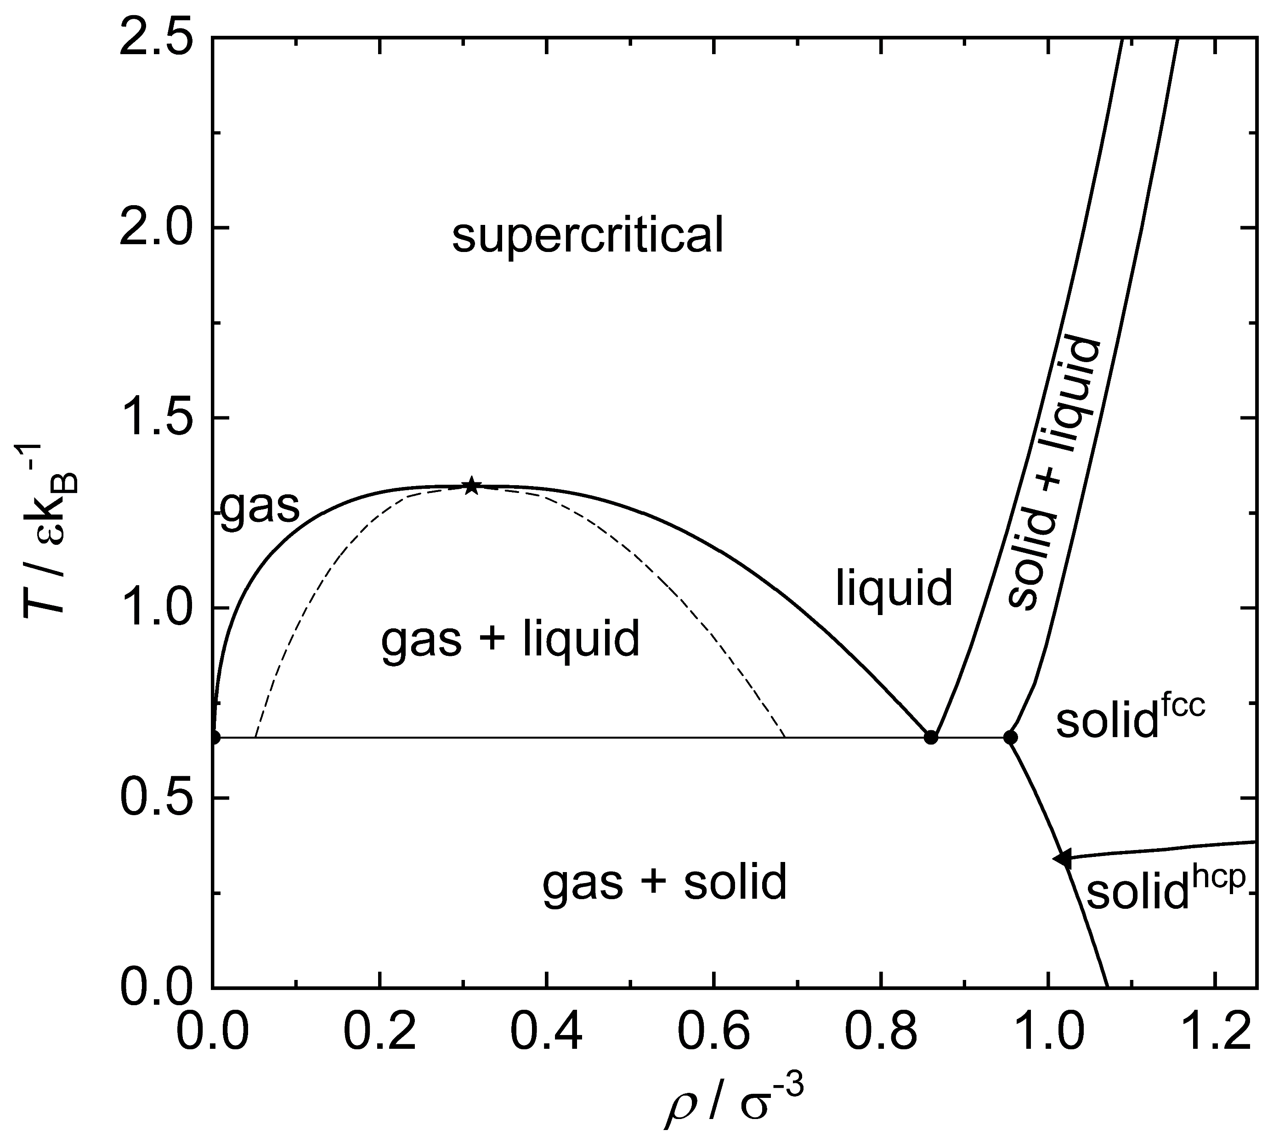
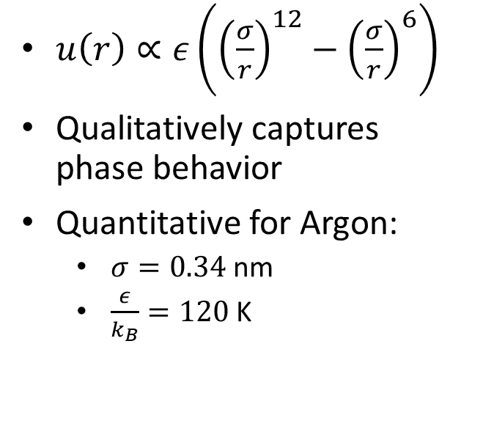
Lennard-Jones Phase Diagram
$u\left(r\right)∝ε\left({\left(\frac{σ}{r}\right)}^{12}−{\left(\frac{σ}{r}\right)}^{6}\right)$
Qualitatively captures phase behavior
Quantitative for Argon:
$σ=0.34$ nm
$\frac{ε}{k_{B}}=120$ K
Notes:
https://en.wikipedia.org/wiki/Lennard-Jones_potential
https://commons.wikimedia.org/wiki/File:Argon_dimer_potential_and_Lennard-Jones.png

Slide 10
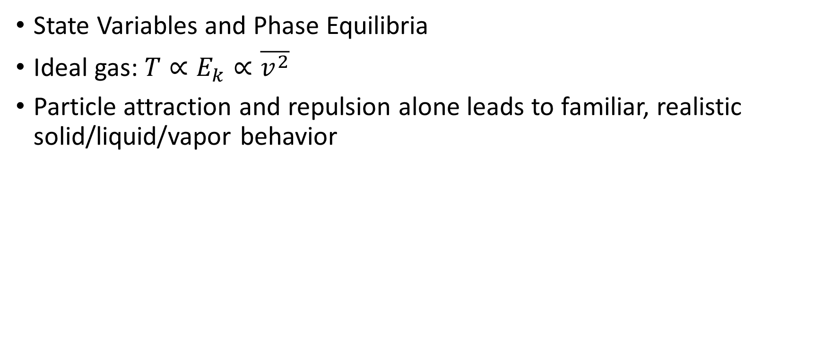
Key Points
State Variables and Phase Equilibria
Ideal gas: $T∝E_{k}∝\overline{v^{2}}$
Particle attraction and repulsion alone leads to familiar, realistic solid/liquid/vapor behavior

Slide 11
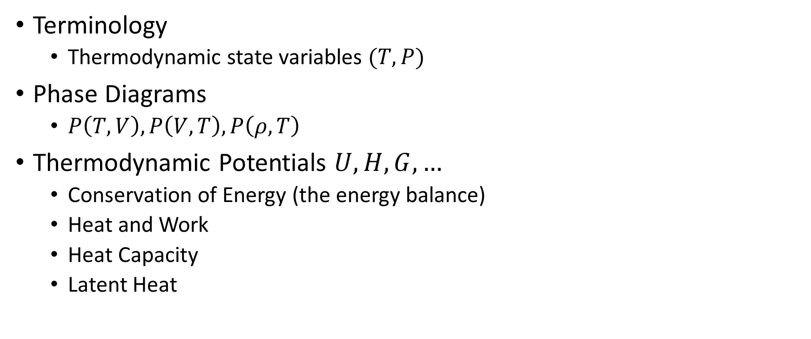
Thursday, August 25
Terminology
Thermodynamic state variables $(T,P)$
Phase Diagrams
$P\left(T,V\right),P\left(V,T\right),P\left(ρ,T\right)$
Thermodynamic Potentials $U,H,G,…$
Conservation of Energy (the energy balance)
Heat and Work
Heat Capacity
Latent Heat

Slide 12
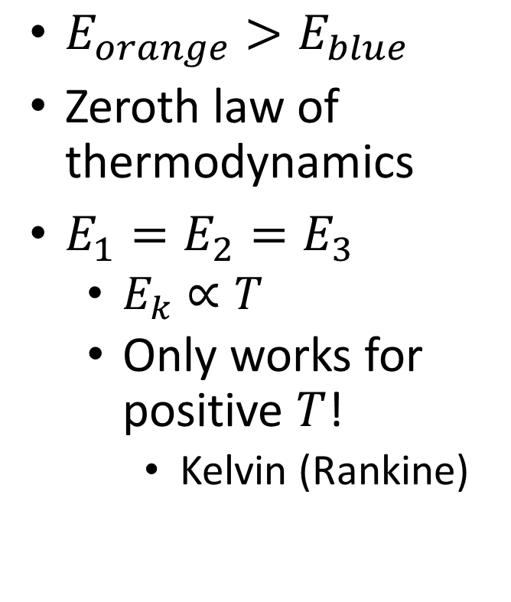

Equilibrium
$E_{orange}>E_{blue}$
Zeroth law of thermodynamics
$E_{1}=E_{2}=E_{3}$
$E_{k}∝T$
Only works for positive $T$!
Kelvin (Rankine)
$$E_{1}=E_{2}$$

Slide 13
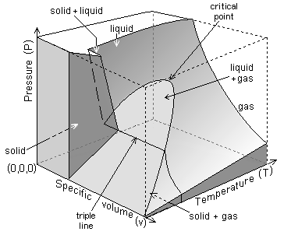
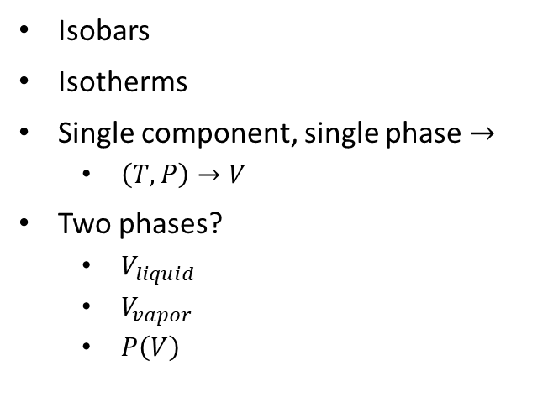
Phase Diagram (Water)
Isobars
Isotherms
Single component, single phase $→$
$\left(T,P\right)→V$
Two phases?
$V_{liquid}$
$V_{vapor}$
$P\left(V\right)$
Notes:
https://en.wikipedia.org/wiki/Properties_of_water

Slide 14
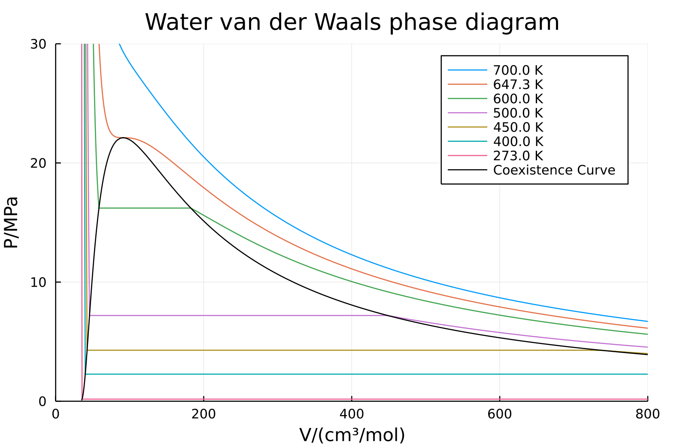
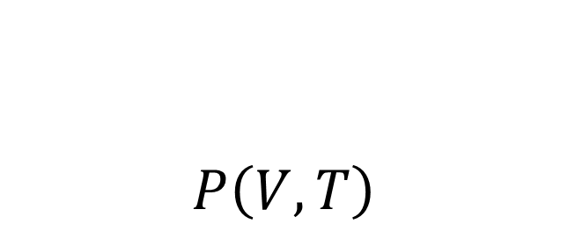
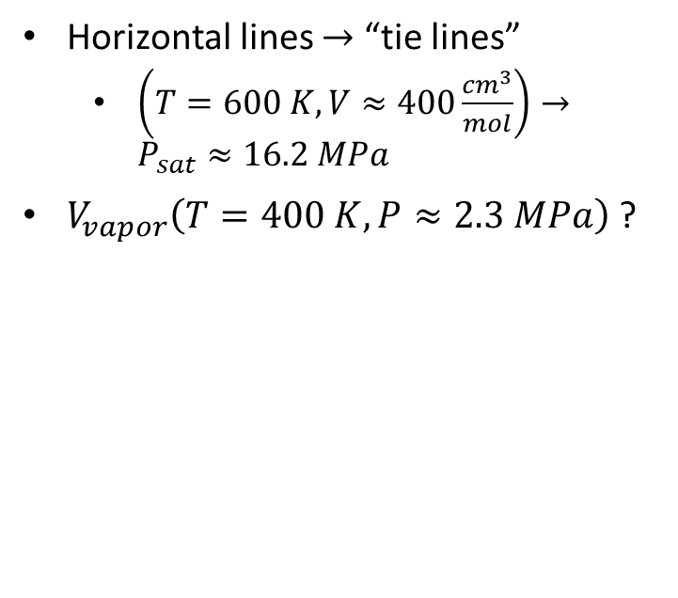
$$P\left(V,T\right)$$
Horizontal lines $→$ “tie lines”
$\left(T=600 K,V≈400\frac{cm^{3}}{mol}\right)→P_{sat}≈16.2 MPa$
$V_{vapor}\left(T=400 K, P≈2.3 MPa\right)$ ?

Slide 15
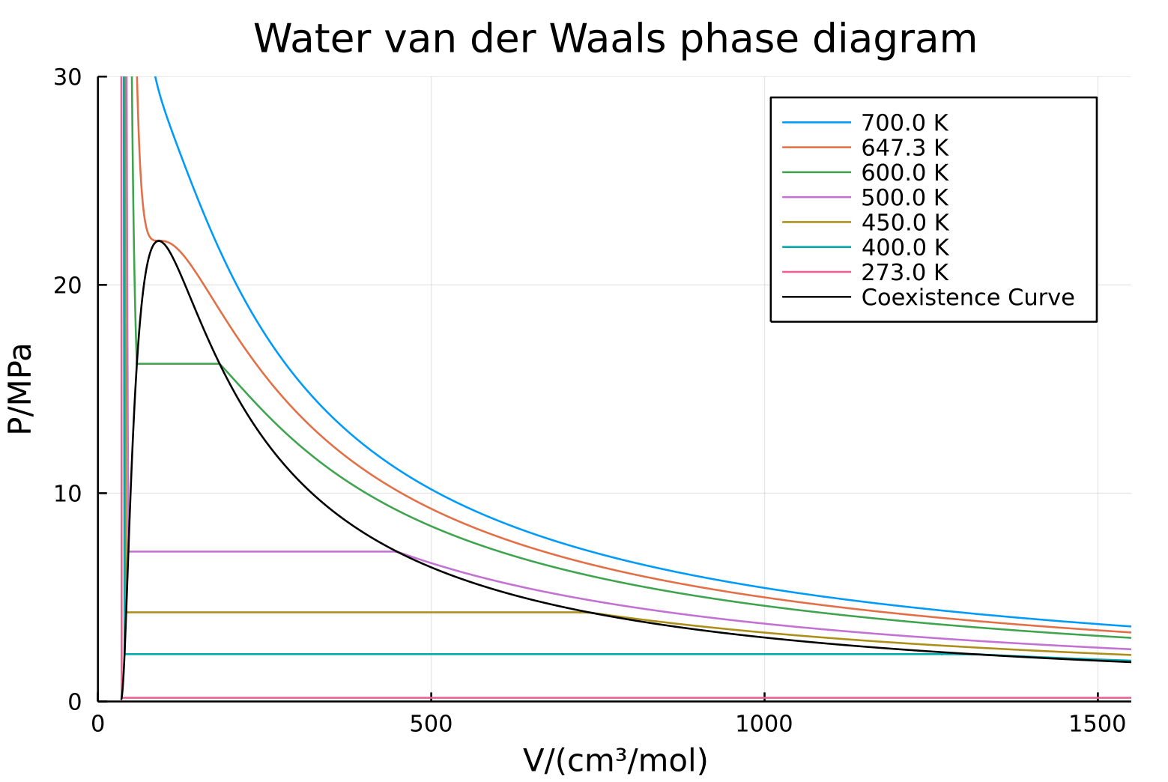
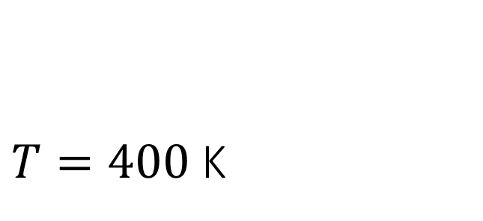
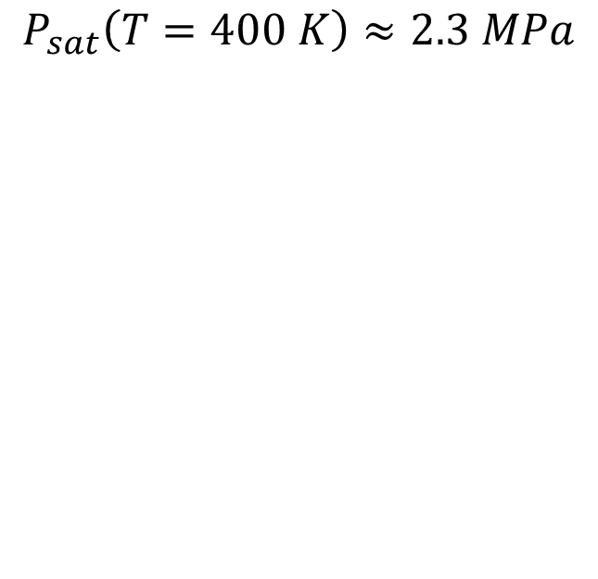
$T=400$ K
$$P_{sat}\left(T=400 K\right)≈2.3 MPa$$

Slide 16
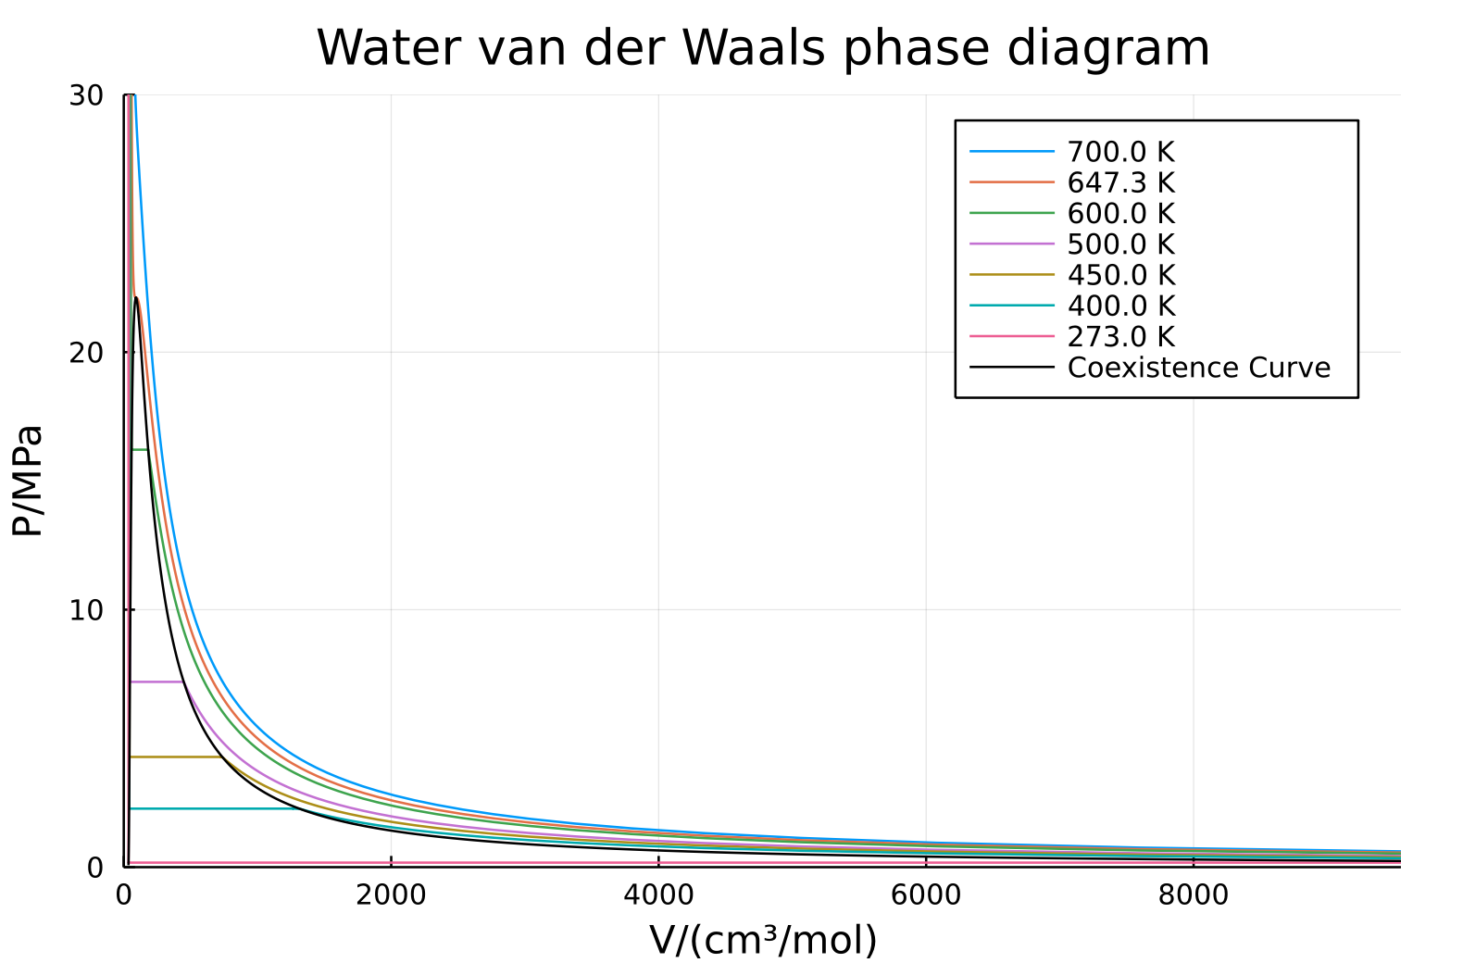
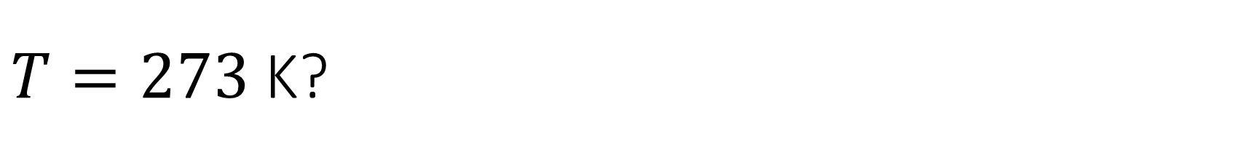
$T=273$ K?

Slide 17
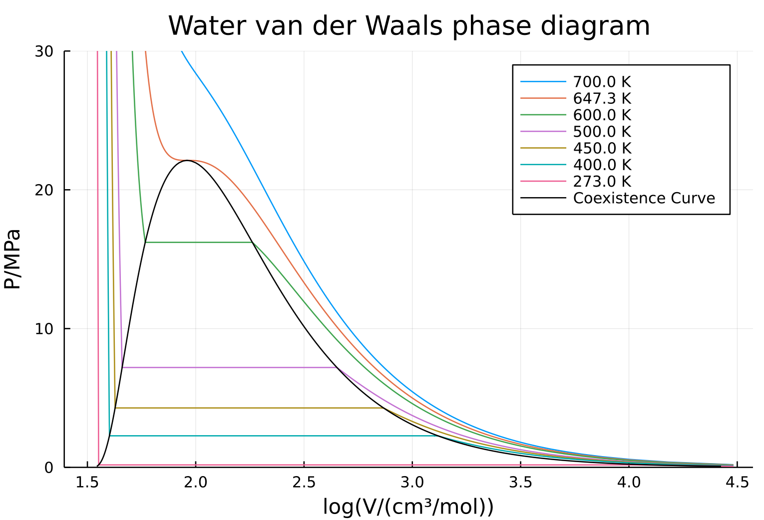
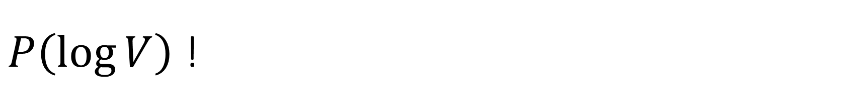
$P\left(\log{V}\right)$ !

Slide 18
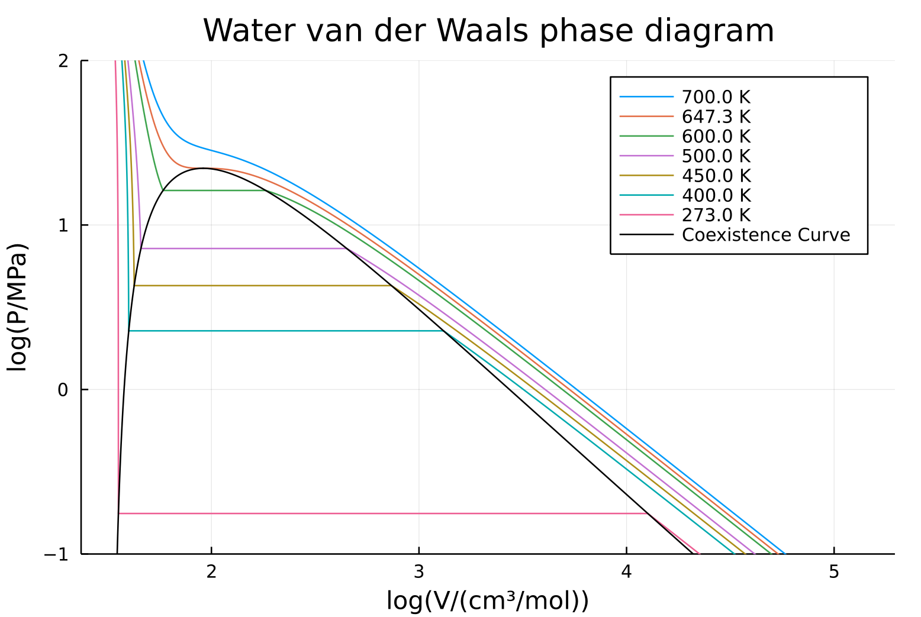
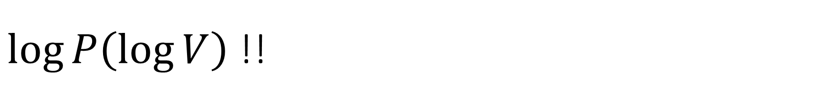
$\log{P\left(\log{V}\right)}$ !!

Slide 19
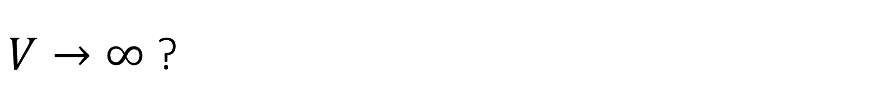
$V→∞$ ?

Slide 20
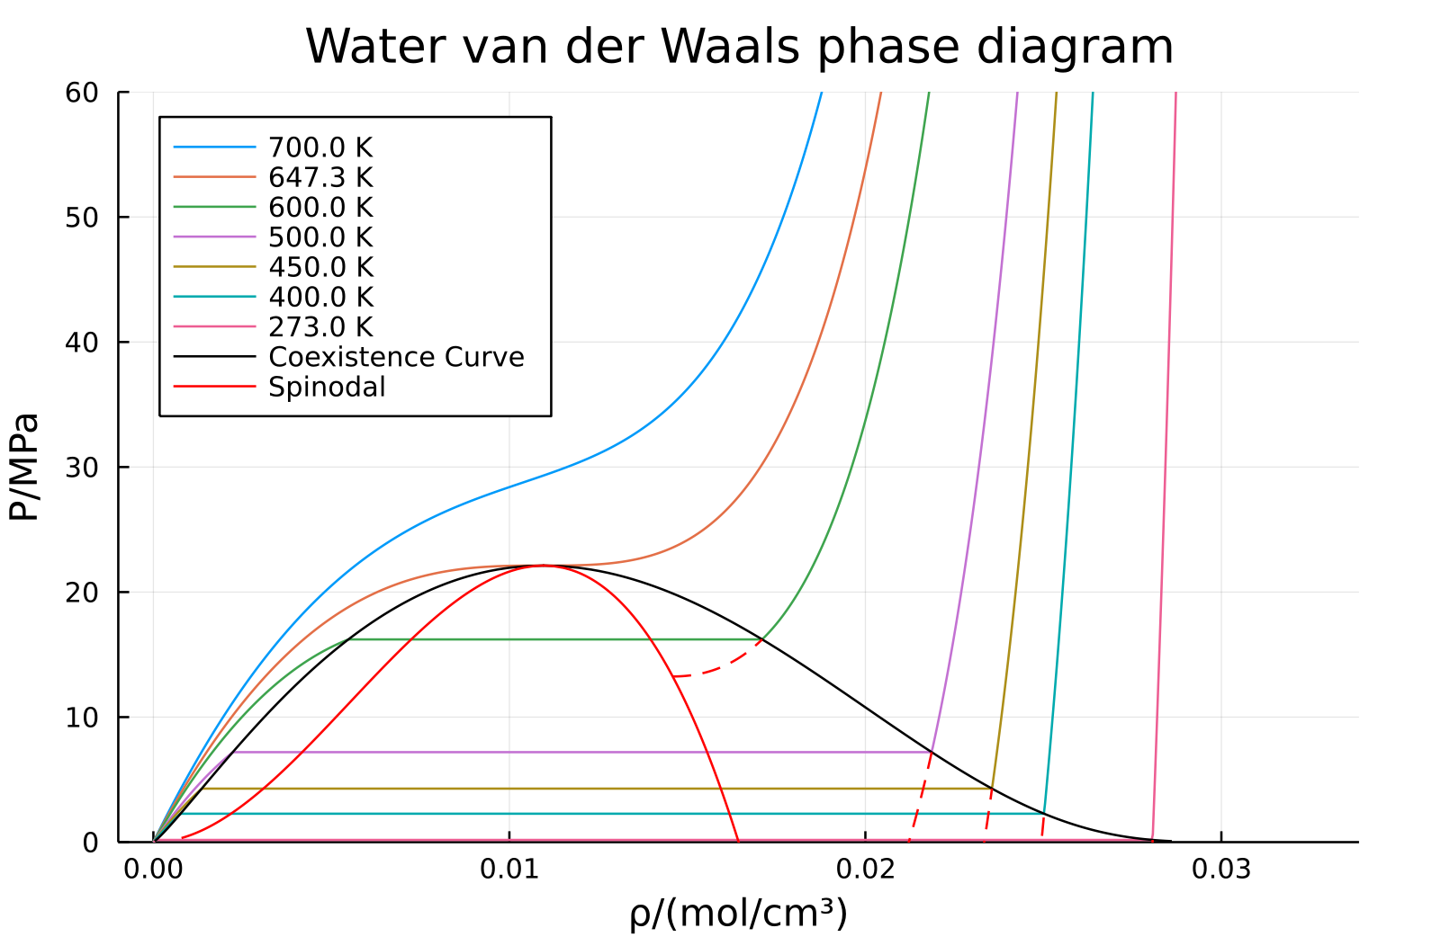

$$P\left(\frac{1}{V}\right)=P\left(ρ\right)$$

Slide 21
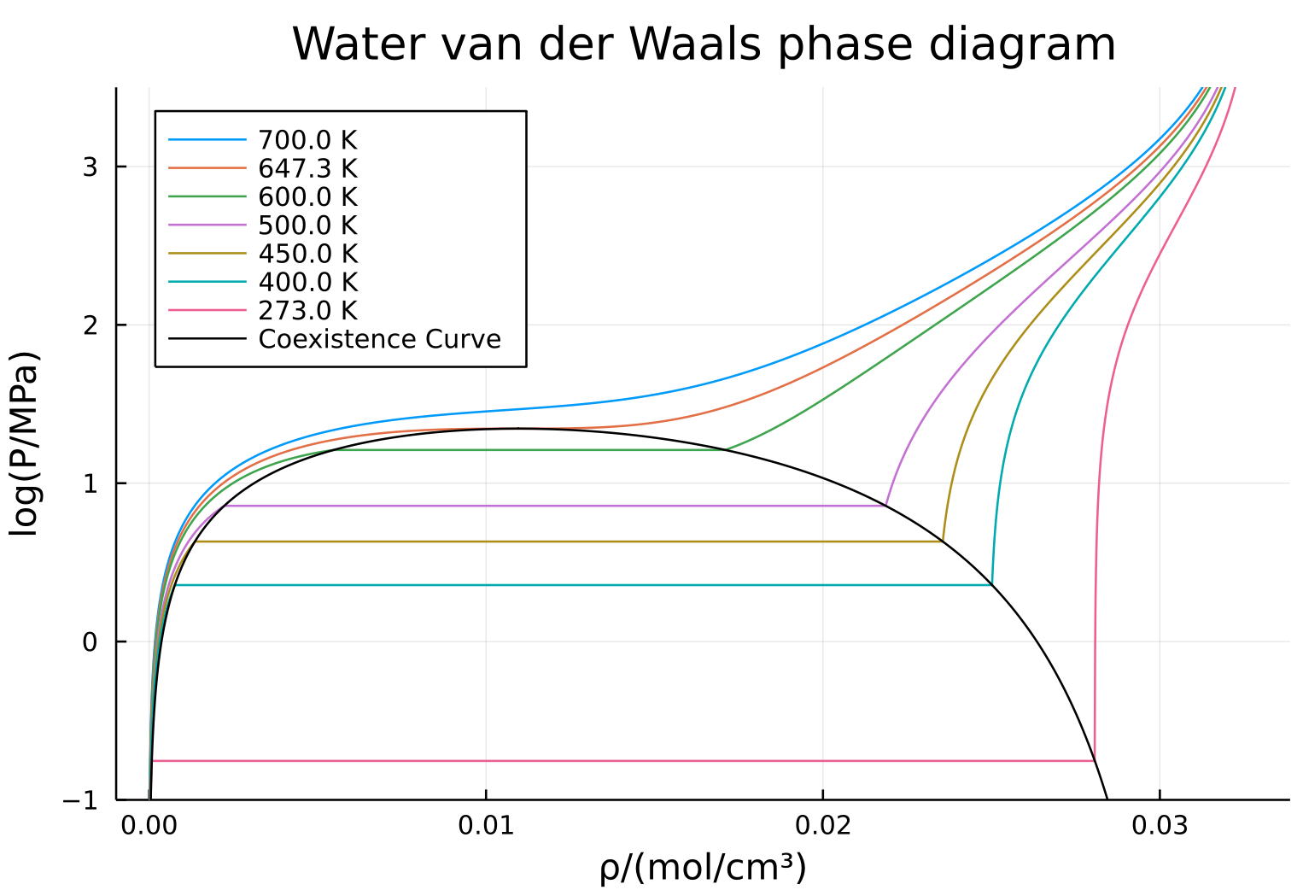

$$\log{P}…$$

Slide 22
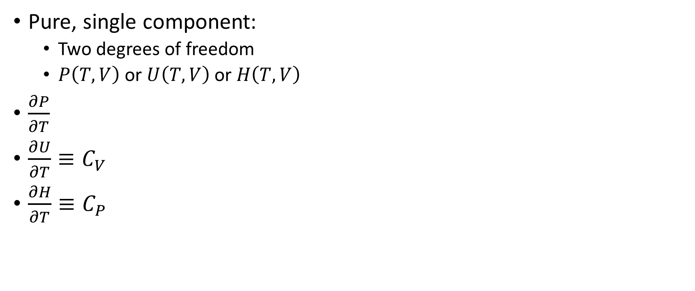
Energy Balances
Pure, single component:
Two degrees of freedom
$P\left(T,V\right)$ or $U\left(T,V\right)$ or $H\left(T,V\right)$
$\frac{∂P}{∂T}$
$\frac{∂U}{∂T}≡C_{V}$
$\frac{∂H}{∂T}≡C_{P}$

